Slide 1
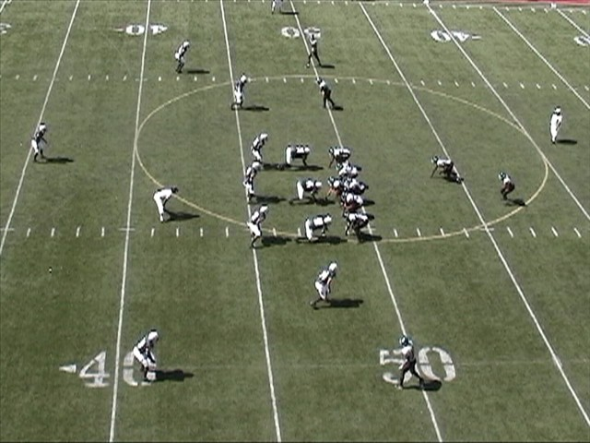
Installation of the 30 Stack Defense
By: James Vint
Attacking Concepts
COPYWRIGHT© 2007 James Vint. This power point is copyrighted and is protected from unauthorized reproduction by the copyright laws of the United States. Unauthorized use or reproduction without the expressed, written consent of James Vint is strictly prohibited.

Slide 2
Topics We Will Cover
Advantages of the 30 Stack
Defensive Priorities
Personnel
Base Alignment Rules
Pursuit Rules
Game Planning Notes

Slide 3
Why The 30 Stack?
Puts Your Athletes On The Field
Easy to Adjust to Multiple Offensive Sets
Linebackers Are Harder To Block Than Down Guys
Allows You Multiple Stunts and Fronts
Linebackers Work From Attack Mode
LB’s Read Less and Play Downhill More
Attack and Redirect rather than Read and React
Can be used every down or as a change-up
Eight Men Can Play The Run Now– Eight Men Can Play The Pass Now

Slide 4
Why The 30 Stack?
Multiple-Front, Stunt, and Coverage Opportunities
Stacked Players Cause Confusion On O-Line
Great versus all offenses and easily adjusted to any formation
Defense Emphasizes Speed Over Size
Can create personnel match-up advantages

Slide 5
Looking At The Stats (Columbus High School)
Gave up just 2.2 ypc,
Created 39 takeaways, including 8 defensive touchdowns
98 Tackles For Loss, 36 Sacks, 31 Hurries
208 Drop Backs: 66-154-16, only 3 TD Passes
5 Shutouts
Held two opponents without a first down
Opponents were 23 percent on 3rd Down
Opponents were 6 of 17 in the red zone with 4 TD’s.
Gave up only 46 yards rushing and 98 total yards per game

Slide 6
Basic Premise of the 30 Stack
Developed to defend modern spread offenses
Versus 10 personnel you can have 6 immediate run defenders while covering the number 2 receivers.
You have linebackers that have immediate access to the B or C gaps.
Forces the offense to keep backs in on protection.

Slide 7
Personnel
Nose: Your nose must be quick, strong like a bull, and force double teams
Ends: Your ends must be able to take on a double team from the tight end and tackle and must be strong enough to not get blown off the ball or washed down on a slant call. Your ends do not need to be big, but they must be strong and athletic. Ideally we want them strong and long
We used fullback types on the defensive line (6-1, 225-230)

Slide 8
Personnel
Mike: Your Mike backer is the strongest of your three backers, but he doesn’t need to be huge. He must be able to redirect and we like a guy with speed. He has to be our quarterback of the box.
Rob/Lou: Our Rob and Lou are speed guys who may be smaller than traditional inside backers. We would like them to be safety types with a little bit of size. They have to be able to blitz well, and must be disciplined enough to stay home while still aggressively pursuing the football. Rob and Lou must be good tacklers as they will get most of your tackles

Slide 9
Personnel
Stud/Hero: These are your strong safeties/Dogs and we did not flip flop them ninety percent of the time. These are athletic kids who can run and tackle. These are where your smart, quick, good tackling athletes play. You want guys who can play force, take on a fullback, yet still drop into pass coverage and chase down the football. We put tough kids here that can run.

Slide 10
Personnel
Corners: Our corners are guys who can play man coverage in space. We play a lot of man coverage. We want to have guys with good feet who can break on routes. Our corners must stop the deep ball and keep the six yard routes at six, and the ten yard routes at ten.

Slide 11
Personnel
Free Safety: This is our best athlete in an ideal situation. We look for a kid with some size, some speed, and a lot of football smarts to quarterback our secondary. He adjusts more than any other player, so he must be dependable to get lined up. He makes all of our coverage calls and checks, and must be able to read quarterback intentions.

Slide 12
Defensive Goals
WIN!
Hold Our Opponents To 3.0 YPC
Hold Opponents to 10 Points or Less
Get 3 Turnovers
Score or get a turnover in score zone
Prevent Big Plays… No Runs over 12 yards… No Passes over 20 Yards
No TD’s after sudden change
50% 3 and Out
Win 3rd Down 75% and 4th Down 100%
Hold Opponents to less than 50% Completion
Hold Opponent to 150 yards of total offense

Slide 13
For Your Players
Learn What To Do
Learn How To Do It
Practice Hard and Fast
Be A Team Player
Develop A Sense of Urgency

Slide 14
Defensive Absolutes
Stop The Run: No one will run the football successfully against our defense. We will commit as many people to the LOS as necessary in order to stop the run.
Control the Pass: We are primarily a zone coverage team. We will take away the deep ball and not allow our opponent to score on big plays. We will be proficient in our coverage packages. Our secondary will play hard and fast, forcing incomplete passes and turnovers.

Slide 15
Defensive Absolutes
We will be the best tackling team in our conference! We emphasize fundamental tackling with extreme effort. We will punish ball carriers and develop an attitude and swagger necessary to dominate our opponent.
Pursuit: We will get 11 people to the football every play! It does not take talent to hustle to the football. We want as many of our helmets on the ball carrier as we can each play.
Create Takeaways: We must create turnovers to give ourselves opportunities for a short field.

Slide 16
Turnovers
We will create a minimum of three turnovers a game by attacking our opponent. We will work our strip and takeaway drills everyday in practice until they become second nature.
Lift and tear
Lift and Punch
Scoop and Score
Slide and Secure

Slide 17
Pursuit and Passion
DEFENSE IS ABOUT PURSUIT AND PASSION!
YOU MUST TEACH HUSTLE IN ALL DRILLS
PURSUIT DRILL MUST BE DONE EVERYDAY!
PUT YOUR ATHLETES ON THE FIELD
NEVER SACRIFICE SIZE FOR ATHLETICISM

Slide 18
D Line Rules
Nose Aligns in 0
Ends Line UP in 4’s, unless we adjust by game plane or front.
Ends play the C gap as a base
Nose plays opposite A gap as the Mike.
Ends Drop On Thunder, Lightning, and Storm
Penetrate to the Butt of the Offensive lineman and find the football
Outside Rusher has Peel on Swing
Hammer, Rocky, and Lunatic puts ends in B Gap
C Gap Rusher has Counter/Cut/Boot/Reverse

Slide 19
Defensive Line Techniques
Defensive lineman will line up with a slightly elongated stance. In passing situations we want the butt in the air
The foot that is back will be the hand that is down.
Weight will be 60 percent on the hand
Use a ball key, ball moves, you move
“The foot replaces the hand”
We attack 1/3 of the man! We never play the middle of the man unless on a bull technique.
We attack our gap shoulder and feel the block of the offensive lineman. We want to be physical on the gap shoulder
Maintain gap integrity while squeezing the gap.
Never penetrate past the butt of the offensive lineman
Control your gap and maintain gap integrity

Slide 20
Alignment Rules (Backers)
Mike: Lines up Stacked over the nose
Lou: Lines up in a 50 on our LDE
Rob: Lines up in a 50 on our RDE
Our backers line up 5 Yards off the ball
Backers can stem pre-snap, but must not get caught out of position and more than a half gap from their assignment
To Trips, trips side backer will align based on game plan and assignment

Slide 21
Inside Backer Rules
Run, Draw, Screen, Pass—ATTACK DOWNHILL
Mike Keys The Offensive Guard To Flow (FB)– Mike Keys A Gap (Frontside)
Lou and Rob Key The Gap Shoulder of their lineman to flow. Lou and Rob play B gap in our base
If Lou or Rob is in an Up technique on TE, Squeeze the D into the C. Limit TE Release
Stacked Backers take three key steps aggressively downhill and read key
LB’s are the last players to Drop on pass
Attack First, Then Redirect
Don’t get caught too close to the LOS- Play at 5 Yards
Know where your outside help is located
MAKE THE DLINE RIGHT!

Slide 22
Dogs Rules
Line Up Splitting The Distance from EMOL and WR versus pro look. If no ISWR, you have D gap force
Versus two receivers, play inside leverage to head up on #2, unless game plan calls for adjustments. You have force/support. Defend the bubble
Versus Trips, line up on #2 at 5 yards and collision number 2. You must defend the bubble.
On closed side, reduce alignment to 4x4. We can reduce further based on game plan
Key EMOL for run/pass, low hat/high hat. WR key is #2. Buzz Hook/Curl to Flat– You have a numbers drop
Do Not Get Locked Inside On Toss!

Slide 23
Alignment Rules Dogs
Versus 1 receiver open: Split the distance between the receiver and the EMOL at 5 yards.
Versus pro look (WR w/TE): Split Distance at five yards.
Versus Twins: Line up 1 yard inside the #2 receiver until #2 breaks the triangle. Then, triangle align using #2 and the EMOL
Versus Trips: Follow twins alignment rules- Adjustments will be made based on down, distance, personnel, and game plan
To a TE Closed: Line up 4x4 on the TE, with a tough adjust by call. We will make adjustments based on down, distance, and matchup.

Slide 24
Secondary Rules
Play Head Up in Cover 3, and inside in Cover 0 and Cover 1.
To a closed side, roll up and play 2 outside the EMOL and 9 of the ball.
Press puts you at one yard, jamming the receiver. Get on jam and shimmy your feet. Disrupt the release to your funnel.
Play over the top first in all coverages. Don’t get beat deep!
Play the Hands of the Wideout to the ball. Always Play Through the Outside Shoulder
When you go for the interception, be sure and without hesitation.
When you play the run, be sure.

Slide 25
GAP FITS
The 30 Stack is an attacking gap control defense
It is imperative that each player understand their gap responsibility
No one is allowed to attack a gap other than the gap they are assigned
You must practice gap fits everyday!
You must have a player responsible for each run gap.

Slide 26
Alignment and Gap Rules
D
C
B
A
A
B
C
D
9
6
7
4
4i
2
0
2
4
6
5
3
2i
1
1
2i
3
4i
5
7
9

Slide 27
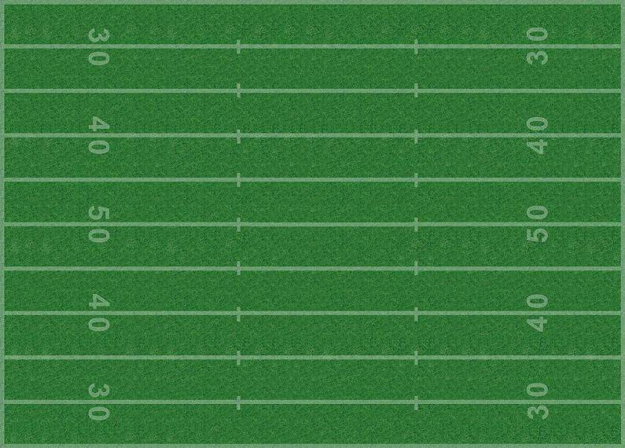
Our Base Alignment
E
N
E
$
L
M
R
H
C
C
F
Vs. Twins Open

Slide 28
Our Base Front-- Illustrated

Slide 29
Our Base Alignment
E
N
E
$
L
M
R
H
C
C
F
Vs. 2x2

Slide 30
Our Base Alignment
E
N
E
$
L
M
R
H
C
C
F
Vs. 2 Back Pro

Slide 31
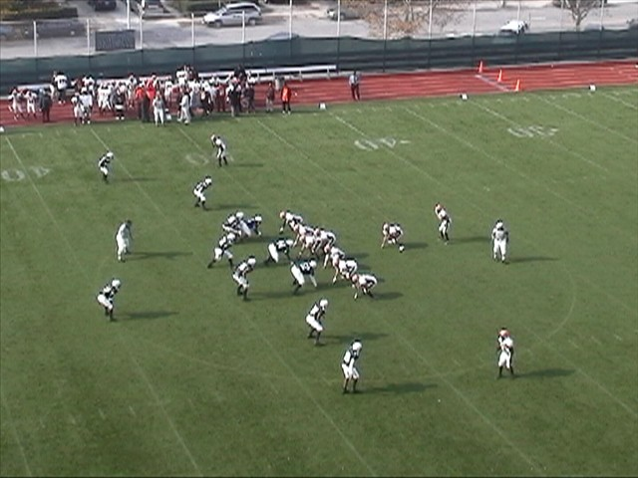
Vs. I Pro

Slide 32
Our Base Alignment
E
N
E
$
L
M
R
H
C
C
We have several adjustments for teams that run trips/trey sets
F
Vs. Trey Open

Slide 33
Our Base Alignment
E
N
E
$
L
M
R
H
C
C
We will run automatic calls versus empty personnel based on our game plan.
F
Vs. Trey Empty

Slide 34
Our Base Alignment
E
N
E
$
L
M
R
H
C
C
Against Empty Sets we will go to our Dime Look
F
Vs. Twins Closed

Slide 35
Our Base Alignment
E
N
E
$
C
L
M
R
H
C
F
Vs. Intermediate Bunch

Slide 36
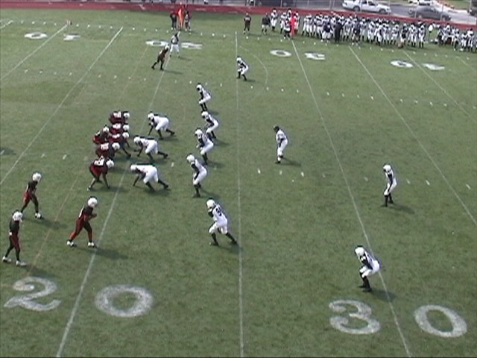
Base vs. Intermediate Bunch
BS Corner makes a lock call and takes the inside away.

Slide 37
Our Base Alignment
E
N
E
$
L
M
R
H
C
C
F
Vs. Tight Bunch

Slide 38
Our Base Alignment
E
N
E
$
L
M
R
H
C
C
F
Vs. Delaware Wing

Slide 39
Our Base Alignment
E
N
E
$
L
M
R
H
C
C
F
Vs. Delaware Slot

Slide 40
PURSUIT
The Key To Great Defense
30 Stack Pursuit Rules

Slide 41
Understanding Pursuit Rules
Dogs are force players on most fronts. They attack the OS shoulder of the ball carrier and keep everything inside of them while making plays. They must make a force call
The backside dog must play cutback, boot and reverse before pursuing across the B Gap. He is the second level chase player.
If you have an I’m here player, you can be aggressive on flow away.
We must declare a force player each play.

Slide 42
Attack, Collapse, Chase
Attack players aim across the belt of the ball carrier. They must fill space when the ball is forced inside.
The collapse players aim one yard inside the inside number of the ball player to play the cutback. They can’t over pursue.
The Chase players are backside players. They must play trap, counter, and reverse. The Chase end must get as deep as the ball and take reverse away. The chase backer and dog must not cross the A gap until they are sure.

Slide 43
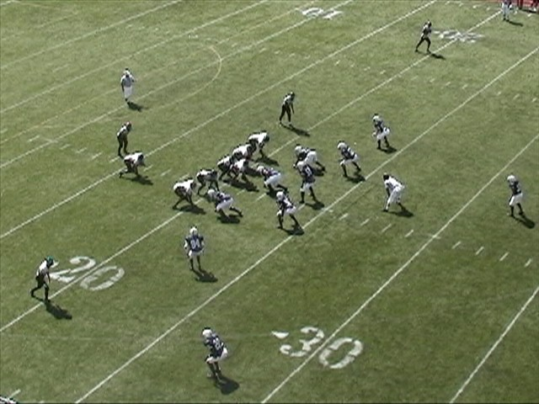
Making an I’m here call
The Hero alerts the Lou backer that he is an “I’m here player”

Slide 44
Understand Pursuit Rules
The frontside backer and DE are the attack players.
The Nose and Mac play Collapse
The Backside Backer and End are the chase players.
We practice pursuit 10 minutes each day with no exceptions
We work sweep pursuit, power pursuit, and draw pursuit
Never run into or follow a player with your colored jersey!

Slide 45
Pursuit Rules Illustrated
Attack
Chase Contain
Collapse
E
N
E
Force
2nd level Chase
Attack
$
L
M
R
H
Chase
Collapse
This Illustration gives you a look at the angles for a sweep/edge run.

Slide 46
Team Sweep Pursuit
E
N
E
C
$
L
M
R
H
C
F

Slide 47
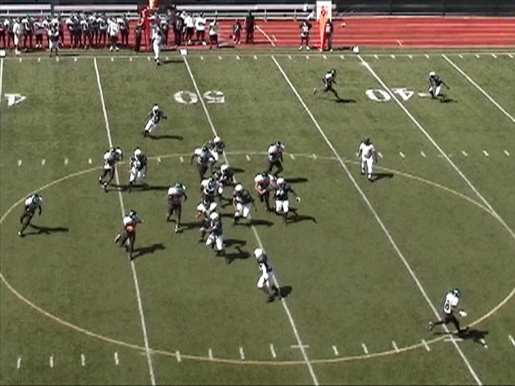
Pursuit Rules Illustrated

Slide 48
Determining Strength
We will establish a formation strength every down.
We want to determine where are greatest threat is located.
We call out personnel and make a tight call as the offense gets set.
We use the alignment of the backs, receivers, and tight ends to determine strength.

Slide 49
Determining Strength
E
N
E
$
L
M
R
H
C
C
F
Versus a 2 Back Pro look, we will make a tight left and a strong left call. We would make a 21 call, indicating that the offense has two backs and 1 TE in the backfield.

Slide 50
Determining Strength
E
N
E
$
L
M
R
H
C
C
F
Versus an ace look we would make a tight left call. Our free safety will determine the passing strength on 1 back sets. We would make an 11 call for personnel.

Slide 51
Determining Strength
E
N
E
$
H
L
M
R
C
F
C
Versus a trey tight look we would make 2 Tight call to alert that we have two tight ends. We would make a 12 call based on personnel. Everyone simply follows their alignment rules.

Slide 52
Determining Strength
E
N
E
$
H
C
L
M
R
C
F
Versus an even look the FS will alert that the formation is balanced. Based on our game plan assessment, we will adjust our personnel accordingly. Some teams might be field oriented, and some might be oriented to work to the QB’s arm.

Slide 53
Game Planning
We will get as many films as they will give us.
We focus on:
Down and Distance
Formation By Personnel Group
Play by Formation
Field/Boundary Strength
Field/Boundary Tendency
Personnel Tendency
When Do They Run Screens and Draws?

Slide 54
Game Planning POE
Who is their best player?
Who is their playmaker?
Who is their 3rd Down Guy?
What is their favorite play?
What are they known for?
What and who do we have to stop to win?
What match-up can we win?
Can we defeat their protection?
Who can we cover man-to-man?

Slide 55
Put Your Game Plan On Paper
Each player gets a copy of our game plan
Our players must know formation, personnel, and down and distance tendencies
Preparation can allow you to overcome a lack of talent
Our players are given a test by their position coach on Weds.
They must know the game plan.
Keep the game plan simple to guarantee success!

Slide 56
Concepts of the 30 Stack
James Vint
jvint@iwc.edu
(646) 721-7155
COPYWRIGHT© 2007 James Vint. This power point is copyrighted and is protected from unauthorized reproduction by the copyright laws of the United States. Unauthorized use or reproduction without the expressed, written consent of James Vint is strictly prohibited.

