Slide 1
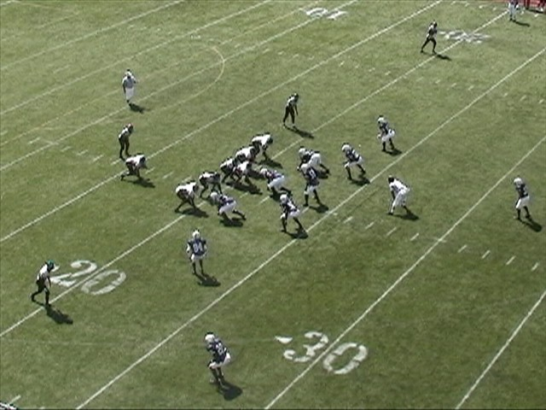
Defending The Run With The Odd Stack Defense
James Vint
jvint@iwc.edu
COPYWRIGHT© 2007 James Vint. This power point is copyrighted and is protected from unauthorized reproduction by the copyright laws of the United States. Unauthorized use or reproduction without the expressed, written consent of James Vint is strictly prohibited.

Slide 2
Topics We Will Cover
Defensive Absolutes
Personnel in the 30 Stack
Alignment Rules Versus Formations
Fronts
Stunts
Blitzes
Defending Specific Concepts
Defending Personnel Groups

Slide 3
Defensive Absolutes
We will stop the run!
We will control the pass!
We will be the best tackling team in our conference!
We will have great pursuit and get 11 defenders to the football using proper angles!
We will create takeaways!

Slide 4
Why The 30 Stack
Puts Your Athletes On The Field
Linebackers Are Harder To Block Than Down Guys
Allows You Multiple Stunts and Fronts
Linebackers Work From Attack Mode
LB’s Read Less and Play Downhill
Attack and Redirect rather than Read and React
Great Change-Up To Your Base Front

Slide 5
Looking At The Stats (Columbus High School)
Gave up just 2.2 ypc,
Created 39 takeaways, including 8 defensive touchdowns
98 Tackles For Loss, 36 Sacks, 31 Hurries
208 Drop Backs: 66-154-16, only 3 TD Passes
5 Shutouts
Held two opponents without a first down
Opponents were 23 percent on 3rd Down
Opponents were 6 of 17 in the red zone with 4 TD’s.
Gave up only 46 yards rushing and 98 total yards per game

Slide 6
Personnel
Nose: Your nose must be quick, strong like a bull, and force double teams
Ends: Your ends must be able to take on a double team from the tight end and tackle and must be strong enough to not get blown out or down on a slant call. Your ends do not need to be big, but the must be strong and athletic. Ideally we want them strong and long

Slide 7
Personnel
Mike: Your Mike backer is the strongest of your three backers, but he doesn’t need to be huge. He must be able to redirect and we like a guy with speed. He has to be our quarterback of the box.
Rob/Lou: Our Rob and Lou are speed guys who may be smaller than traditional inside backers. We would like them to be safety types with a little bit of size. They have to be able to blitz well, and must be disciplined enough to stay home while still aggressively pursuing the football. Rob and Lou must be good tacklers as they will get most of your tackles

Slide 8
Personnel
Stud/Hero: These are your strong safeties/Dogs and we did not flip flop them ninety percent of the time. These are athletic kids who can run and tackle. These are where your smart, quick, good tackling athletes play. You want guys who can play force, take on a fullback, yet still drop into pass coverage and chase down the football. We put tough kids here that can run.

Slide 9
Personnel
Free Safety: This is our perhaps best athlete in an ideal situation. We look for a kid with some size, some speed, and a lot of football smarts to quarterback our secondary. He adjusts more than any other player, so he must be dependable to get lined up. He makes all of our coverage calls and checks, and must be able to read quarterback intentions.

Slide 10
Personnel
Corners: Our corners are guys who can play man coverage in space. We play a lot of cover 3 from this defense, but we use man principals. We want to have guys with good feet who can break on routes. Our corners must stop the deep ball and keep the six yard routes at six, and the ten yard routes at ten.

Slide 11
Basic Run Concepts
We play an attacking Gap Control Concept
Each Box Defender is responsible for 1 Gap
We attack the gap shoulder of our run key
We will be aggressive and get down hill
Maintain Gap Integrity
We will pursue to the football through our gap and into our proper pursuit lanes
Everyone must be relentless in pursuit

Slide 12
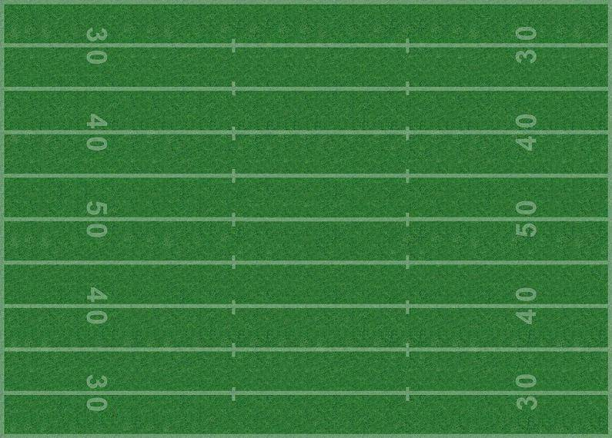
Our Base Alignment
E
N
E
$
L
M
R
H
C
C
F
Vs. 2x2

Slide 13
Base Front
E
N
E
$
L
M
R
H
 | ALIGN | GAP | TECH | RUN TO | RUN AWAY | PASS | SPRINT
NOSE | O TECH | BS A GAP | GAP CONT | COLLAPSE | COLLAPSE | 2 WAY GO | HIP POCKET
TE | 4 TECH | C GAP | GAP CONT | ATTACK | CHASE | RUSH CONT. | ATTACK
OE | 4 TECH | C GAP | GAP CONT | ATTACK | CHASE | RUSH CONT. | ATTACK
M | STACK AT 5 | FS A GAP | GAP ATT | COLLAPSE | COLLAPSE | LOW HOLE | TRAIL DEPTH
L | 50 TECH | B GAP | GAP ATT | ATTACK | CHASE | HASH DROP | CHECK/GO
R | 50 TECH | B GAP | GAP ATT | ATTACK | CHASE | HASH DROP | CHECK/GO
S | Split at 5 | D GAP | Pat feet | Force/Fold | CHASE | #'S DROP | FLAT CHECK
H | Split at 5 | D GAP | Pat feet | Force/Fold | CHASE | #'2 DROP | FLAT CHECK

Slide 14
Determining Strength
We will make a tight and a strength call.
We want to determine where are greatest threat is located.
We call out personnel and make a tight call as the offense breaks the huddle.
We use the alignment of the backs, receivers, and tight ends to determine strength.
We will make a personnel call.

Slide 15
Understanding Pursuit Rules
Force- Frontside player who will attack the play at the POA. Traditionally this will be our Stud and Hero.
Attack- Frontside 1st and 2nd level players who will attack the flow of the football.
Collapse- Frontside or Middle 1st and 2nd level players who will pursue through the immediate cutback lanes.
Chase: Backside players who must secure the backside versus counter, trap, reverse, and boot.

Slide 16
Understand Pursuit Rules
The frontside backer and DE are the attack players.
The Nose and Mac play Collapse
The Backside Backer and End are the chase players.
We practice pursuit 10 minutes each day with no exceptions
We work sweep pursuit, power pursuit, and draw pursuit
Never run into or follow a player with your colored jersey!

Slide 17
Pursuit Rules Illustrated
Attack
Chase Contain
Collapse
E
N
E
Force
2nd level Chase
Attack
$
L
M
R
H
Chase
Collapse
This Illustration gives you a look at the angles for a sweep/edge run.

Slide 18
Team Sweep Pursuit
E
N
E
C
$
L
M
R
H
C
F

Slide 19
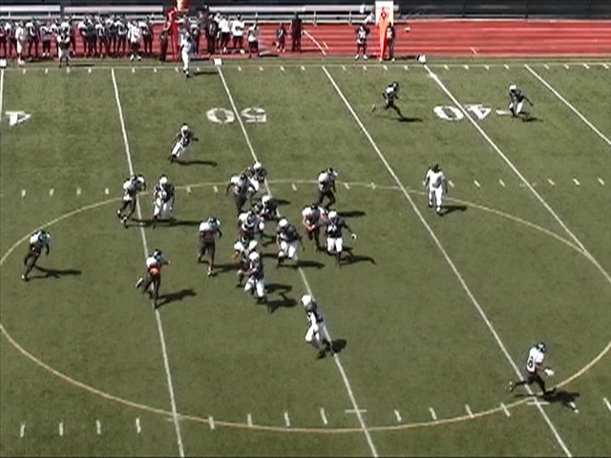
Pursuit Rules Illustrated

Slide 20
Defending Popular Two Back Concepts
Lead/Iso
Power/Toss
Inside Zone
Outside Zone
Option Responsibilities

Slide 21
Defending The Lead/Iso
The playside backer must wreck and spill the play
We teach our backer to spill the play to help.
Our Mike must take on the Iso block with his outside shoulder. Our Lou and Rob take on the Iso block with their inside shoulder.
TAKE ON ISO BLOCKS AT LOS!
We want to create a triangle to the football.
Our dogs must play force/fold, staying home for the bounce, then folding inside to help on the tackle.

Slide 22
Defending the Isolation Play
We are creating a triangle around the football.
E
N
E
$
H
L
M
R
C
C
F
The playside end must not get turned out– He must restrict the space.
The Lou must attack FB at LOS

Slide 23
Defending The Power
We must restrict the kick out block.
Our defensive end must play tough against down block and double team. He must not get driven more than 1 yard off the ball.
We must wreck the FB and turn the play inside.
Our Dog will most likely be taking on the kickout. He must take it on with his IS ½ at the LOS.
Our linebackers must flow and be ready for the ball to be turned back inside.
We must be consistent up front so we can be sound versus play action.
We must defend the boot and counter.

Slide 24
Defending the Power
Our Playside End must get BIG in his gap.
E
N
E
$
H
L
M
R
C
C
F
Our open side invert makes an I’m Here call.

Slide 25
Defending the IS/OS Zone
We must read and control our gap shoulder.
DL can’t get reached and pinned on outside zone.
Constrict your gap shoulder.
LB’s must make a quick read and track gap shoulder. Find the window
Do Not over pursue!
Backside Boot player must stay home!
Take away the cutback by staying in your pursuit lanes.
Work down the line without getting too much penetration.

Slide 26
Defending The Option Game
Must have clear option assignments
Have a change-up on your assignments
Teach kids about different option plays
Must take away their best element
Remain Fundamentally Sound!
Alter the Mesh Point
Don’t try to emulate the option game
Teach kids to control the big play

Slide 27
Defending IS Veer
E
N
E
$
L
M
R
H
C
C
F
A and B gap players play dive
C Gap player has QB
D Gap player has pitch
Alley player has QB to pitch

Slide 28
Defending IS Veer (Lilly Call)
E
N
E
$
L
M
R
H
C
C
F
Mike and our End have Dive.
Rob has QB.
D Gap player has pitch
Alley player has QB to pitch

Slide 29
Lilly Switch
E
N
E
$
L
M
R
H
C
C
F
Switch alerts our Dog he will play QB.
Our LB will play pitch.
This is a great change-up

Slide 30
OS Veer
E
N
E
H
$
L
M
R
C
C
F
Our Dog to the TE must be alert to feather
Our End must be strong against a double team.
Our Rob and Mike must read gap to flow
Our Hero will be alert to feather!

Slide 31
Rocket Call to TE for OS Veer
E
N
E
$
L
M
R
H
C
C
F
We tell our Hero if the QB still has the ball, feather. Give us time to rally.
Be in a position to tackle the QB if he turns upfield.
When you have a TE to your side, be alert for OS Veer.

Slide 32
Defending Spread Sets
We will discourage the bubble by alignment.
We will not get in a bad coverage match-up.
We will always have a quarterback player if they are an option team.
We will game plan to eliminate their best running threat.
We must understand which concepts they are running.
When in doubt, be aggressive in your base.

Slide 33
Defending Spread Sets
Understand down and distance!
Teach your players how to be aggressive against the run and still get a good pass drop.
Drill your players on the high/hat low/hat concept.
Understand their will be no lead play without motion.
Who will the read player be?
What are their formation tendencies?

Slide 34
Our Base Alignment vs. Ace
E
N
E
$
M
H
C
L
R
C
F
Key: The tight side end must be able to restrict the C gap.
Our Stud will be the Force Player on any outside run to his side. We have no I’m here call

Slide 35
Our Base Alignment vs. Spread
E
N
E
$
M
H
C
L
R
C
F
We will defend bubble by alignment.
Our 6 run players must be aggressive and understand down and distance.
Our backers will deepen up.

Slide 36
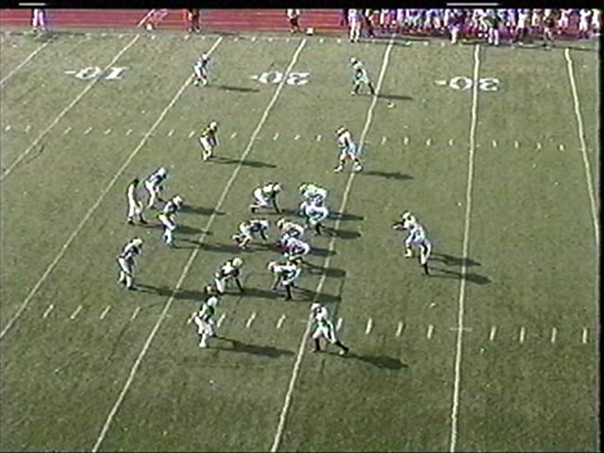
Our Base look vs. Spread

Slide 37
Defending Zone Read and Speed Option
E
N
E
$
L
M
R
H
C
C
F
We must have a pitch and QB player to the side of the back for speed option. We must have a QB player for Zone Read. In this case, our C gap player has QB. Our D gap player has pitch on speed option.

Slide 38
Lunatic Check Cover 3
E
N
E
$
H
C
L
M
R
C
F
Key: The End to the back’s side must play the B gap.
The Lou will be our QB player! We want to entice a pull read. Out end must not let himself get washed down.

Slide 39
Uzzi Check Cover 3
E
N
E
$
H
C
L
M
R
C
F
Key: The Lou and the Stud will come off the edge.
We will play man behind this.
The FS will creep pre-snap.
We run this to take away zone read and ZR option.

Slide 40
Front Adjustments in The Odd Stack
Demon- Stack Defense with Cover 2 Shell
Eagle- Open side DE plays in a loose 3
Philly- Tight Side End Plays in a loose 3
Double Eagle- Both Ends Play in loose 3 techniques
Up– Linebacker to the Tight End Plays in a 6 Tech.
Wyoming- Rob and Lou line up 2 yards outside the EMOL

Slide 41
Hammer Technique
E
N
E
$
H
L
M
R
C
C
F
Hammer alerts our defensive end to the tight end they will slam the B gap shoulder of the guard.
To run this stunt away from our tight or strength call we would call Drill.
To both sides, we would make a build call.

Slide 42
Demon Front
E
N
E
$
L
M
R
C
C
F
H
Our Hero or Nickel will become the 2nd safety
Our Gap assignments remain the same
Our Hero is still the force player unless we change our coverage call
Very good front versus 2x1 and 3x1 formations

Slide 43
Demon Front vs. Trips
E
N
E
$
L
M
R
C
C
F
H
Our Hero or Nickel will become the 2nd safety
The Stud follows his trips alignment rules
Our Hero Rolls back to the play the open side safety.
We can either roll our free safety down, or hammer the trips side end.

Slide 44
Double Eagle Front
E
N
E
$
L
M
R
H
C
C
F
Our Ends will now play B gap unless we make an adjustment
Our Rob and Lou now play C Gap
Ends must take the B Gap Away

Slide 45
Double Eagle Front vs. 2x2
E
N
E
$
L
M
R
H
C
C
F
Our Ends will now play B gap unless we make an adjustment
Our Rob and Lou now play C Gap
Ends must take the B Gap Away

Slide 46
Up Front
L
E
N
E
$
M
R
H
C
C
F
LB to the TE will play in a 6 tech- He must control TE
Tight Side End must control the tackle
Mike and Rob will bump over ½ gap
Mike favors the A gap but must help on the B gap.

Slide 47
Taking Away The Tight End Side Run
Front Adjustments
Stunts
Blitzes
Smoke– Wide Stud Blitz
MOB– Mike Strongside B Gap
MAC– Mike Strongside C Gap Blitz
Coverage Options

Slide 48
30 Philly Up (Stem From Bama)
L
E
N
E
C
$
M
R
H
C
F
Nose-Backside 1 Tech A Gap
Strong End-3 Tech, Squeeze B
Weak End-4 Tech Squeeze C
MAC-10 Frontside, Frontside A Gap
Lou-6 On TE-Squeeze C Gap
Rob-Inside Leg of End, Attack B
Stud-D Gap Force on Sweep
Hero-LB Depth, Split Distance, C Gap Force
Corners-5 to 7 Yards, Head UP, C-3
Free-B Gap TE Side, C-3

Slide 49
30 Philly Up Hammer MAC
L
E
N
E
$
M
R
H
C
C
F
Nose-Backside 1 Tech A Gap
Strong End-3 Tech Slam A Gap
Weak End-4 Tech Squeeze C
MAC-10 Work B to C (First Daylight)
Lou-6 On TE- Slide to B gap
Rob-Inside Leg of End, Attack B
Stud-D Gap Force on Sweep
Hero-LB Depth, Split Distance, C Gap Force
Corners-5 to 7 Yards, Head UP, C-3
Free-B Gap TE Side, C-3

Slide 50
30 Philly Up Hammer MOB Smoke
L
E
N
E
$
M
R
H
C
C
F
Nose-Backside 1 Tech A Gap
Strong End-3 Tech Slam A Gap
Weak End-4 Tech Squeeze C
MAC-10 Blitz B off Ends Butt (See Flow)
Lou-6 On TE- Squeeze C to B
Rob-Inside Leg of End, Attack B
Stud- Pre Snap Creep- Blitz D
Hero-LB Depth, Split Distance, C Gap Force
Corners-5 to 7 Yards, Head UP, C-3
Free-B Gap TE Side, C-3

Slide 51
30 Philly Up Hammer MOB Slice
Slice alerts our Stud to blitz through the C Gap
L
E
N
E
$
M
R
H
C
C
F
Nose-Backside 1 Tech A Gap
Strong End-3 Tech Slam A Gap
Weak End-4 Tech Squeeze C
MAC-10 Blitz B off Ends Butt (See Flow)
Lou-6 On TE- Squeeze C to B
Rob-Inside Leg of End, Attack B
Stud- Pre Snap Creep- Blitz C
Hero-LB Depth, Split Distance, C Gap Force
Corners-5 to 7 Yards, Head UP, C-3
Free-B Gap TE Side, C-3

Slide 52
Bama Laser Smoke (Rocket Laser Check)
Laser or Rocket puts us on a full slant
E
N
E
$
L
M
R
H
C
C
F
Nose-Frontside A Gap
Strong End-4 Tech C Gap
Weak End-4 Tech Hammer B
Mike- 5 Yards stacked– Attack FS B
Lou-50 Tech, Read Flow
Rob-Stacked, attack A gap
Stud- Pre Snap Creep- Blitz D
Hero-Split Distance, Creep, close Backside
Corners-5 to 7 Yards, Head UP, C-3 or 1
Free-B Gap TE Side, C-3 or C-1

Slide 53
Dangers of Blitzing
When you blitz, you expose weaknesses
Be sure you prepare for worst case scenario
Make sure you account for each gap
Drill your kids on blitz reaction
Drill your kids on which zones are voided and where we are weak.

Slide 54
Defending Personnel Groups
Defending The Wing-T
Defending 31 and 32 Personnel
Defending 21 and 22 Personnel
Defending the 1 back run game

Slide 55
Larry/Lilly
Larry Alerts our defensive line they will go to the gap to their right.
Lilly alerts out defensive line they will go to the gap to their left.
Our linebackers our responsible for the gap opposite the defensive lineman.
You must practice this during your option and pursuit periods.

Slide 56
Defending The Wing-T
Create Chaos with aggressive linebacker play
STOP THEIR BREAD AND BUTTER
Keep your defensive integrity
Keep your keys in-tact
Be aggressive and attack with your front 6
Don’t get outflanked– Force player must keep outside arm free.
As a general rule we want 4 players from the tackle out to the wing side, and 3 players from the tackle out to the open side.

Slide 57
Base vs. Wing T
E
N
E
$
H
L
M
R
C
C
F
Strong End must be aggressive and control C gap shoulder of OT. (We can adjust him to a 5 tech)
The Lou must read his gap key as he attacks.
The Mike must read guard to flow.
Your Stud must be able to spill a pulling guard.

Slide 58
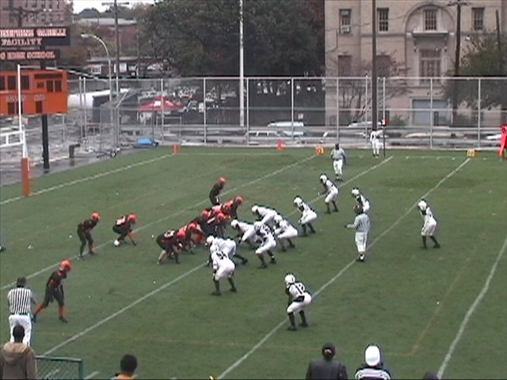
Alignment vs. Wing-T
Base Front

Slide 59
Larry vs. Wing T
E
N
E
$
H
L
M
R
C
C
F
The End hammers the B gap hard.
The End will spill any trap play.
The Mike will key the block on the nose as he attacks.
The Lou has C Gap

Slide 60
Defending Jet Sweep
E
N
E
$
H
L
M
R
C
C
F
We will have a Lilly Call.
The End will work to “spin the shoulder”.
The Mike will key the block on the nose as he attacks.
The Lou has C Gap

Slide 61
Larry vs. Wing T
E
N
E
$
H
L
M
R
C
C
F
Lou keys TE (Can’t Get Down Blocked)
The ends must beat up their gap shoulder.
The Hero and Rob must play Counter X.
The Hero is our Waggle Player
The Nose, Rob, and Mike Play Trap

Slide 62
Up Front vs. Wing T
L
E
N
E
$
M
R
H
C
C
F
LB to the TE will play in a 9 tech- He must not get down blocked!
The end now has to squeeze the C.
The backers must line up in 30 techniques. Mike must be a beast!

Slide 63
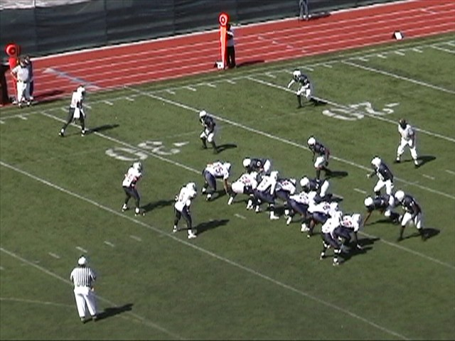
Up Front Illustrated

Slide 64
Defending 31 and 32 Personnel
Stop their best athlete!
Keep your backers at their proper depth.
Backers have a tendency to creep too close to the line versus 3 back sets.
Be aggressive with your force player, but don’t let him cross the LOS by more than 1 yard.
Your players must understand leverage
Your C gap players must control the C Gap.
We frequently adjusted our Dogs to 2x2 or 3x3 alignment

Slide 65
Our Base Alignment vs. Wishbone
E
N
E
$
H
L
M
R
C
C
F
Key: The tight side end must be able to restrict the C gap.
Our Stud and Hero will be the Force Players. They will fold inside on Iso

Slide 66
Our Base Alignment vs. I Tight
E
N
E
$
H
L
M
R
C
F
C
Key: The tight side end must be able to restrict the C gap.
Our Stud and Hero will be the Force Players. They must not get too far up field!

Slide 67
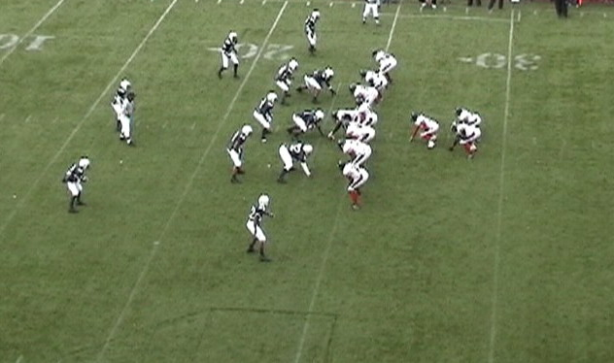
Base Front vs. 32 Personnel

Slide 68
Defending 21 Personnel Sets
21 Personnel: 2 Backs 1 TE
We will line up in our base front.
By alignment we should be in great shape to the open side.
We will play cover 0, 1, 2, 3, and 4.
We will always have an I’m Here Player.

Slide 69
Our Base Alignment vs. Twins Closed
E
N
E
$
H
L
M
R
C
C
F
Key: The tight side end must be able to restrict the C gap.
Our Stud will be the Force Player on any outside run to his side. He will play fold on Iso.

Slide 70
Our Base Alignment vs. Twins Open
E
N
E
$
H
L
M
R
C
C
F
Key: This can become a trips concept.
We can make a hammer call to the fullback’s side.

Slide 71
Hammer Call vs. Twins Open
E
N
E
$
H
L
M
R
C
C
F
Key: Our Rob must take on the lead block on OS Lead or Toss.

Slide 72
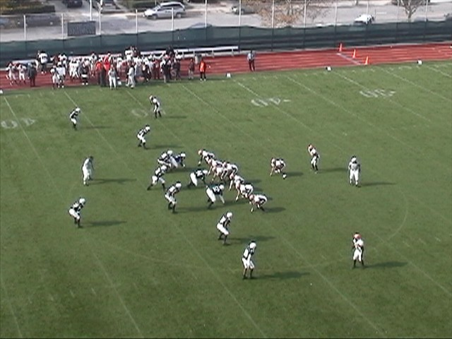
jvint@iwc.edu

