Slide 1

INSTALLING THE 3-3-5 DEFENSE AT THE HIGH SCHOOL LEVEL
DAVID BROWN
HEAD FOOTBALL COACH
NOTRE DAME HIGH SCHOOL
EASTON, PA
(610) 216-5760
ballcoach1@netzero.net

Slide 2
WHY THE 3-3-5 DEFENSE?
Gives Maximum numbers to stop the running game
Able to give a Variety of looks with Minimal Teaching
Pre-snap movement creates Confusion (Organized Chaos)
Physical, Aggressive, Attacking style of play
Allows smaller, faster athletes to be Successful
Fun for the players!
Attacks the Pass Protection weaknesses
Creates Negative Yardage plays and Turnovers
Makes the offense become Protection Oriented

Slide 3
NOTRE DAME FOOTBALL AT A GLANCE
(2-8) (0-11) (1-9) (2-8) (4-6) (9-1)
Record of 9 WINS and 42 LOSSES prior to installation of 3-3-5 Defense

Slide 4
POINTS ALLOWED PER GAME
(2-8) (0-11) (1-9) (2-8) (4-6) (9-1)

Slide 5
2003 DEFENSIVE STATISTICS
29 76 9 13

Slide 6
PERSONNELL
E
N
E
S
L
M
R
S
C
C
F
NOSEGUARD – “Wrestler” type player; must force double teams
ENDS – Agile and fast; substitute size for quickness
MIKE – Tough
LOU LB – Best LB (plays against right side of offense)
ROB LB – Next best available
FIELD SPUR – Best LB/DB combination player; physical; must be able to play man coverage
BOUNDARY SPUR – Less physical than Field Spur; must be able to play man coverage
CORNERBACKS - Cover!
FREE SAFETY – Best player; must “Quarterback” the defense

Slide 7
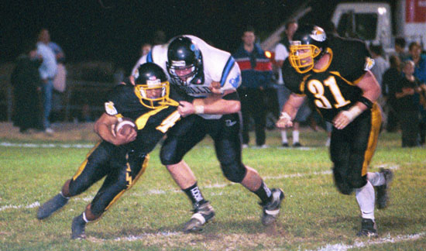
BASE TECHNIQUE/KEYS AND READS

Slide 8
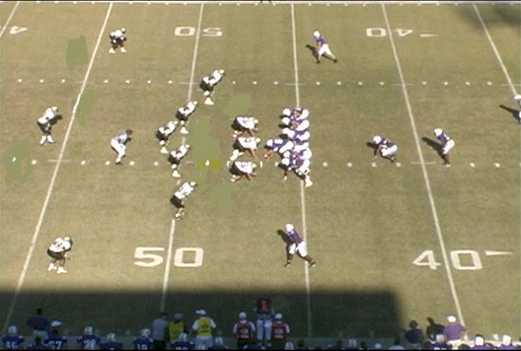
BASE ALIGNMENT VS. PRO
Notes:
Front 6 are always the same regardless to formation. Spurs and DB’s may adjust depending on formation.

Slide 9
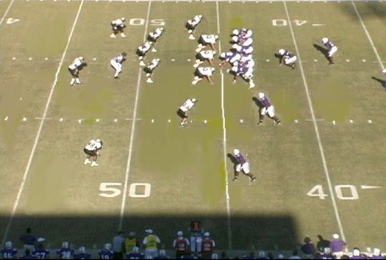
VS. TWINS
Notes:
Left Spur 2x2
Right Spur base alignment is inside leverage @ 4 yards but will change according to split of #2

Slide 10
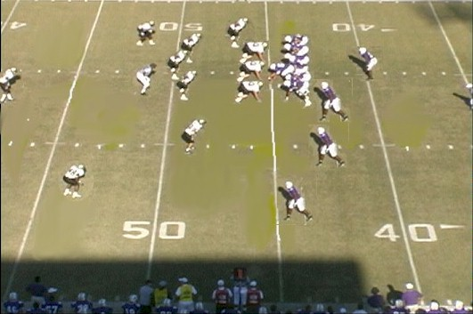
VS. TRIPS

Slide 11
DEFENSIVE LINE AND LINEBACKERS
BASE COVER 3
E N E
L M R
POS | ALIGN | KEY | RUN TO-AWAY | PASS RESP.
LE | 4 TECH | OT | C GAP – TRAIL/REVERSE | OUTSIDE RUSH LANE
NG | 0 STUFF | BALL | A GAP – BACKSIDE A | INSIDE RUSH LANE
RE | 4 TECH | OT | C GAP – TRAIL/REVERSE | OUTSIDE RUSH LANE
LOU | STACK | OG-NEAR RB | FIT | HASH DROP
MIKE | STACK | FB-OG | FIT | HOLE DROP
ROB | STACK | OG-NEAR RB | FIT | HASH DROP

Slide 12
NOSEGUARD PLAY
BASE “STUFF” TECHNIQUE
Alignment: “0” technique, nose-to-nose on Center. Play as tight as possible and still be able to key and react.
KEY: Movement of the Center’s hand.
Responsibility: Attack Center and STUFF him into backfield and find the football.
Coaching Points:
Hold ground on double team.
If reached, play cutback.
Rush passer in proper lane.
On pass rush, bull rush and look for draw or QB to step up.
Stay flat on pursuit.

Slide 13
NOSEGUARD STIMULUS/RESPONSE
Vs. BASE BLOCK
STUFF CENTER. Attack Center. Keep feet moving and stay square.
DO NOT PICK A SIDE.
N

Slide 14
NOSEGUARD STIMULUS/RESPONSE
Vs. REACH BLOCK
STUFF Center. Let his head hook you. Keep shoulders square and squeeze through his back-side looking for cutback. Pursue flat down the L.O.S.
N

Slide 15
NOSE GUARD RIP TECHNIQUE
Alignment: “0” technique, nose-on-nose on Center.
KEY: Guard that you are ripping to. Be aware of feeling pressure from Center.
Responsibility: A Gap that you are ripping to.
Coaching Points:
Back off the ball slightly.
Step with foot to side you are ripping to.
Turn shoulders on first step, then square back up on second step.
The Guard will then tell you how to react.

Slide 16
NOSEGUARD RIP TECH.
Vs. BASE BLOCK
Vs. Base Block: With backside arm, rip quickly to direction you are going. With
Guard firing out, you should beat the Center’s block on your initial step. FIND
Find the football!
N

Slide 17
NOSEGUARD RIP TECH
Vs. REACH BLOCK
As Guard moves away from you, you will feel the Center trying to hook you. Run flat down the L.O.S. in the direction he is going.
N

Slide 18
NOSEGUARD RIP TECH
Vs. SCOOP BLOCK
See Guard coming at you and feel Center go away. Get flat down L.O.S. and chase.
N

Slide 19
NOSEGUARD RIP TECH
Vs. DOUBLE TEAM
Explode low. See Guard coming and feel pressure by Center. Drive hard into Guard and penetrate seam. Create a pile.
N

Slide 20
NOSEGUARD RIP TECH
Vs. DOWN BLOCK
Explode low. See Guard coming and stuff him back and find the ball.
N

Slide 21
DEFENSIVE END 5 TECHNIQUE
Alignment: “4” Technique (head up on OT). Align tight to the L.O.S.
KEY: Movement of OT’s helmet.
Responsibility: C Gap. Contain pass rush and trail on play away.
Coaching Points:
Step flat with outside foot.
Keep shoulders square.
Attack outside number of OT.
Punch with hands and react to OT’s first step.

Slide 22
5 TECHNIQUE
Vs. BASE BLOCK
Step flat and attack OT’s outside number and knock him back while keeping
your shoulders square.
E

Slide 23
5 TECHNIQUE
Vs. REACH BLOCK
Step flat to the outside as normal. As OT tries to reach you, stab him with your
hands while keeping feet moving and shoulders square. Use an escape technique
and find the ball.
E

Slide 24
5 TECHNIQUE
Vs. DOWN BLOCK
Step flat as normal while getting your inside hand on OT pushing him inside. Get
your eyes up attack trapper with your inside arm and compress him. Do not spill.
E

Slide 25
5 TECHNIQUE
Vs. DOUBLE TEAM
Step flat. As OT stays on you and you fell pressure by TE, drop to a knee and use
up both blockers.
E

Slide 26
5 TECHNIQUE
Vs. Y BLOCK
Step flat. As OT pulls outside, the TE will block down on you. Squeeze him back out
or punch and cross face.
E

Slide 27
DEFENSIVE END
LOOP TECHNIQUE
Alignment: 4 Technique
KEY: TE
Responsibility: Attack and control the C Gap. You are looping from a “5” to a “7” Technique.
Execution: When the TE moves, step with the foot that you are looping to and attack TE.
Coaching Points:
Key the TE to get a good read
All other 5 Tech Coaching Points (except keeping OT off LB)

Slide 28
LOOP TECHNIQUE
Vs. BASE BLOCK
Feel the Base Block by OT and squeeze back into him. Expect Isolation. If Option,
You have QB.
E

Slide 29
LOOP TECHNIQUE
Vs. REACH BLOCK
As you step to TE and he’s blocking out, the OT will be hooking you. Stab him with
Your hands while keeping your feet moving. Use an escape technique and get to the
Ball.
E

Slide 30
LOOP TECHNIQUE
Vs. DOUBLE TEAM
Explode into TE and cause a pile if double team; if down block and no pressure
from OT, Hold your ground and make the ball bounce. Once ball clears you,
cross-face and chase flat down the LOS for cutback.
E

Slide 31
DEFENSIVE END
PINCH TECHNIQUE
Alignment: 4 Technique
KEY: The Guard and see the football out of the corner of your eye.
Responsibility: You have the “B” GAP. Attack and control it.
Execution: When the Guard or football moves, step flat with the foot you are
pinching to. Your aiming point is the hip of the Guard. After
stepping flat, crossover with your trail foot while ripping the
backside arm through simulataneously.
Coaching Points:
Key the Guard and ball to get a good jump.
Always beat the OT’s block when going inside vs a scoop block. You have
the B Gap.
Pursue flat down the LOS on ball away.
Rush passer in proper rush lane.

Slide 32
PINCH TECHNIQUE
Vs. REACH BLOCK
Flat step down inside with your playside foot. As OG comes towards you, he will try
And hook you. Punch him with your hands and work back outside.
E

Slide 33
PINCH TECHNIQUE
Vs. SCOOP BLOCK
As the Guard goes away, feel the OT driving down inside trying to cut you off. Flat
Step down and punch the OT with your hands, keeping your shoulders square.
E

Slide 34
PINCH TECHNIQUE
Vs. FAN BLOCK
Attack the V of the neck of Guard and squeeze him back into the hole. Keep your
Feet moving as you drive him back.
E

Slide 35
PINCH TECHNIQUE
Vs. PASS SET
Attack through the hip of the Guard. You have a two way go on the OG.
E

Slide 36
ROB/LOU LINEBACKER STIMULUS/RESPONSE
STIMULUS | RESPONSE
DOWN BLOCK | EYES UP (to near back)
OUT BLOCK (Pull To) | SCRAPE TIGHT
PULL (Pull Away) | SHUFFLE, SHUFFLE, FIT
SCOOP | SAME
REACH | B GAP (if contact, keep outside shoulder free)
HIGH HAT | HASH DROP
ALIGNMENT DEPTH: 4 yards

Slide 37
KEY DRILL FOR ROB/LOU
T
T
C
LB
LB
COACH

Slide 38
MIKE LB TECHNIQUE
Depth – 5 yards
Alignment – Stack
Key – Track of Fullback to OG
Coaching Point – Stay FLAT, tempo the ball
  (over the top player)

Slide 39
MIKE LINEBACKER STIMULUS/RESPONSE – TRAP TRACK
T
C
T
MLB

Slide 40
MIKE LB VS. ISO TRACK
T
C
T
MLB

Slide 41
MIKE LB VS. POWER/BELLY TRACK
T
C
T
COACHING POINT:
STAY FLAT, TEMPO THE BALL
MLB

Slide 42
MIKE LB VS. COUNTER
T
C
T
COACHING POINT:
STAY FLAT, TEMPO THE BALL
MLB

Slide 43
SPUR ALIGMENTS
A
L
I
G
N
M
E
N
T
S
3
4
4
E E
S S
3
Inside
2
4
S S
2

Slide 44
SPUR STIMULUS/RESPONSE
Key: BALL (On or Off the L.O.S./Run-Pass)
*Bounce 3 times at snap to get read
STIMULUS | RESPONSE
Inside Run to | C Stack (Bonus Player in the box)
Inside Run Away | C Stack – Fold/Cutback
Outside Run to | Force
Outside Run Away | Fold, Cutback
Pass | Numbers Drop (flat)

Slide 45
INSIDE RUN
“C”
STACK
“C” STACK,
FOLD/CUTBACK

Slide 46
OUTSIDE RUN
FORCE
FOLD/CUTBACK

Slide 47
BASE COVER 3
VIDEO CLIPS

Slide 48
NOTRE DAME CRUSADER
FOOTBALL
DAVID BROWN
HEAD COACH
NOTRE DAME HIGH SCHOOL
EASTON, PA
(610) 216-5760
ballcoach1@netzero.net

